Slide 1
Background
The system is useful for the owner to ensure
The house is save from the house burn
80% deaths and 74% injuries were caused by home fires
The house is save from the robbery
crime index for house break-in & theft in year 2017 is 16200 cases
The system is also for the energy saving that the owner can control the system in the from the website

Slide 2
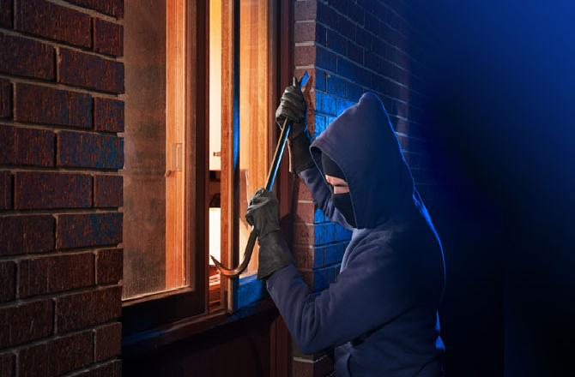
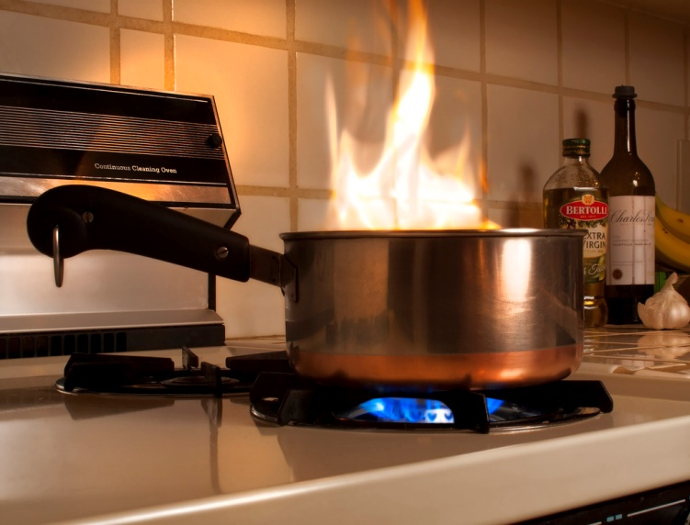
Problem statement
Intruders
Home owner forget to turn off the kitchen appliance

Slide 3

Objective
To develop a safety and secured smart house that can be monitored and controlled when owner is way.
To design and test the assembly of hardware, software and all electrical part for the proposed smart house system.

Slide 4
Scope of Project
Arduino MEGA
LED
LCD
Camera
Sensor
Gas
Flame
LDR
IR
Temperature
To aim a energy efficient house
To make owner feel save from robbery or burned house
Alarm will turn on to inform there is intruder ,gas leak or the flame

Slide 5
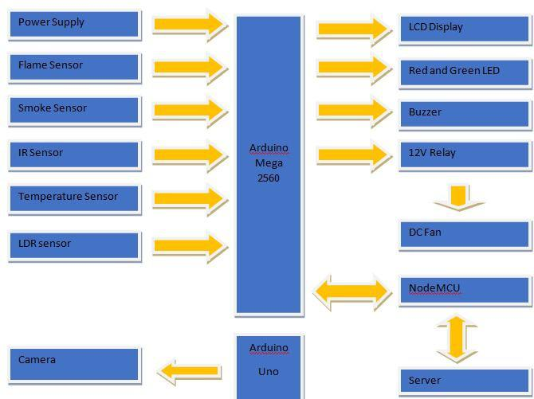
BLOCK DIAGRAM

Slide 6
FLOWCHART

Slide 7
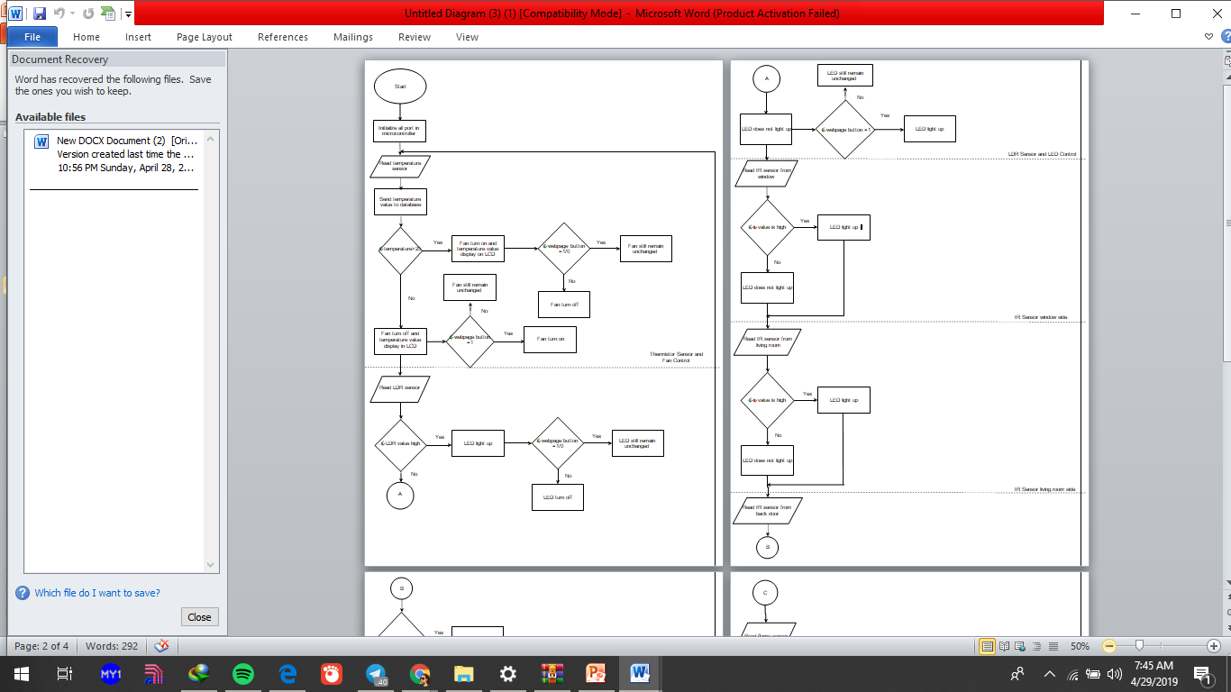

Slide 8
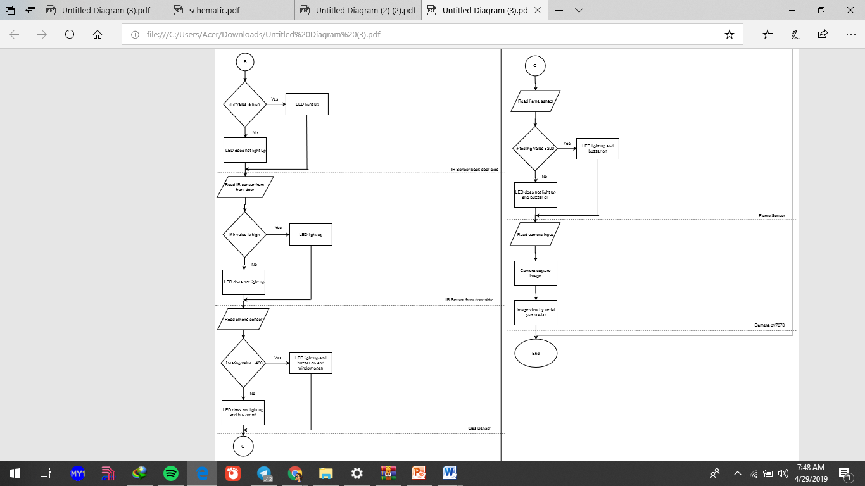

Slide 9
SCHEMATIC

Slide 10
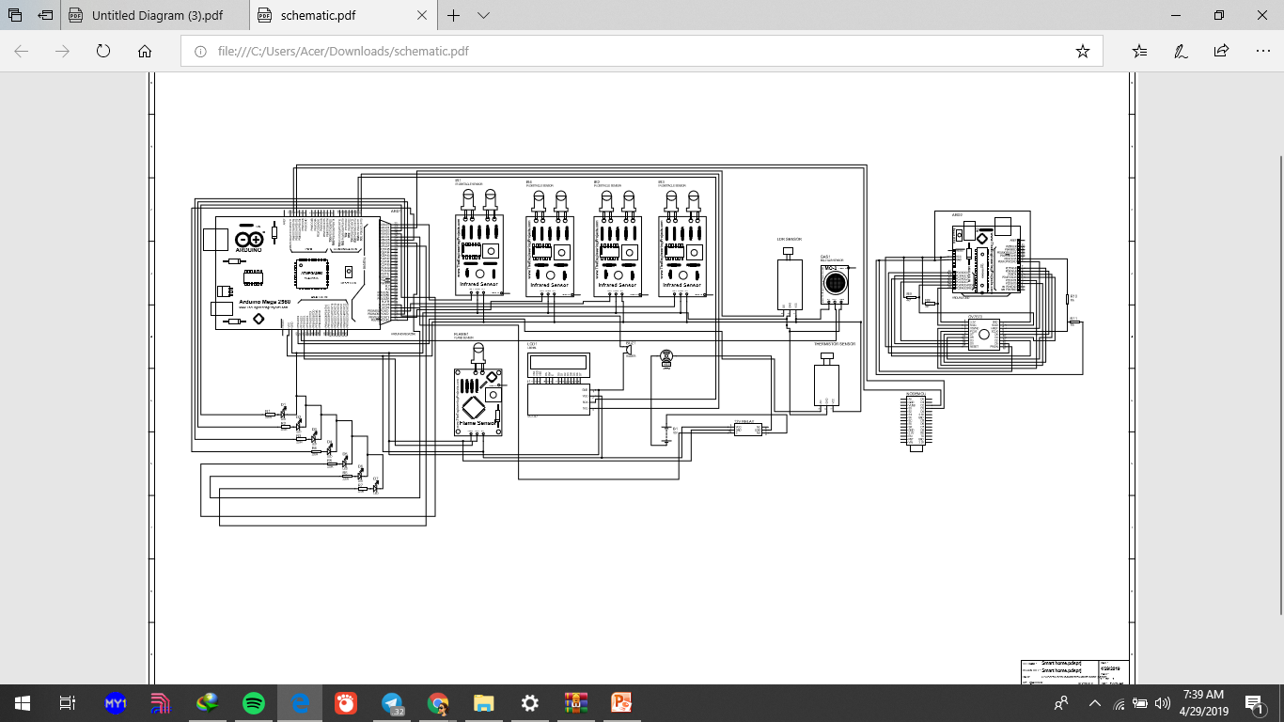

Slide 11
RESULT

Slide 12
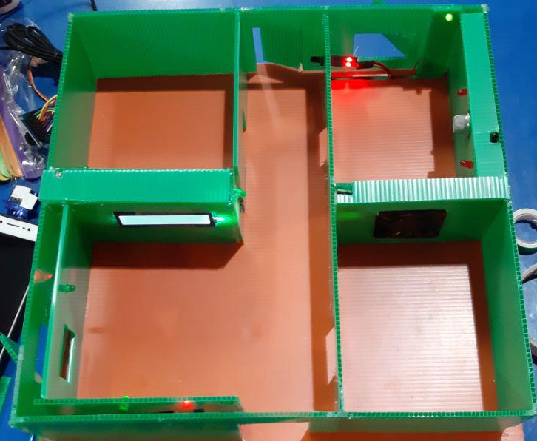
Gas sensor
Flame sensor
Will turn on the buzzer
Temperature sensor
Display the temperature to the LCD
Fan is turn on or off when the room is
hot or using the website
LDR sensor detect light in the room and light up the LED when then room is dark
LCD display the temperature
IR sensor
To detect the movement of the intruder for the door and window

Slide 13
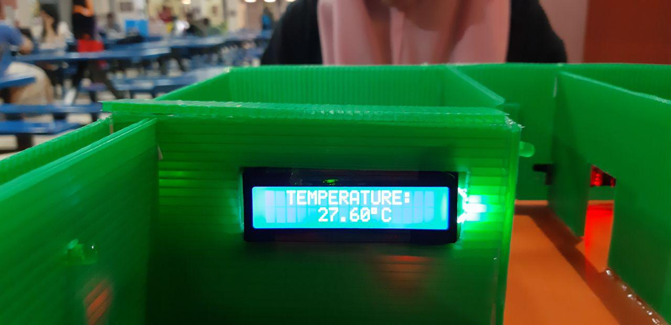
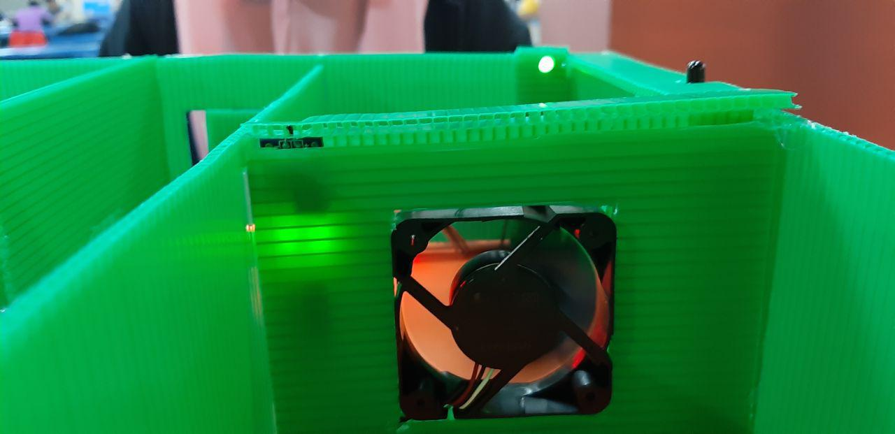
LCD will display the temperature in the house by reading the temperature sensor
Fan will turn on if the temperature exceed the threshold value.
Fan also can be controlled by using the website

Slide 14
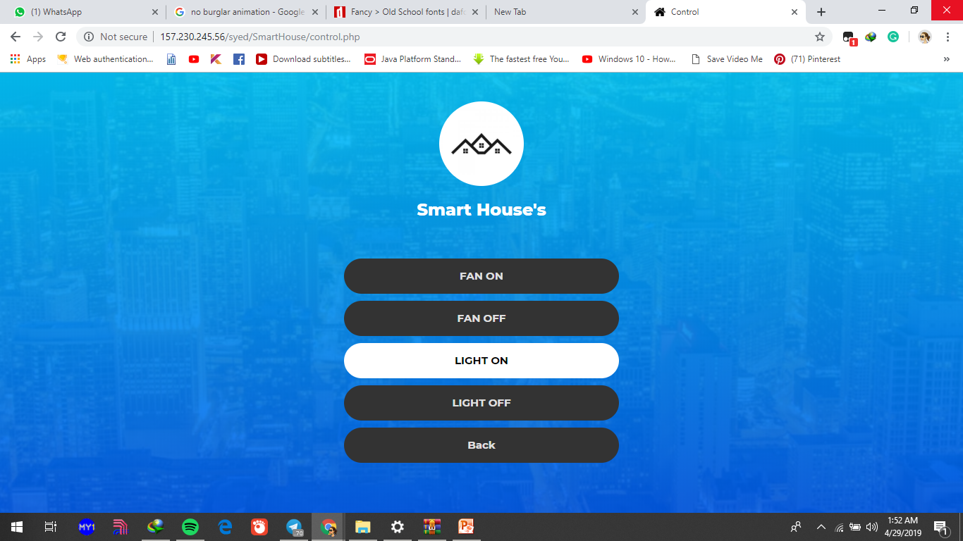
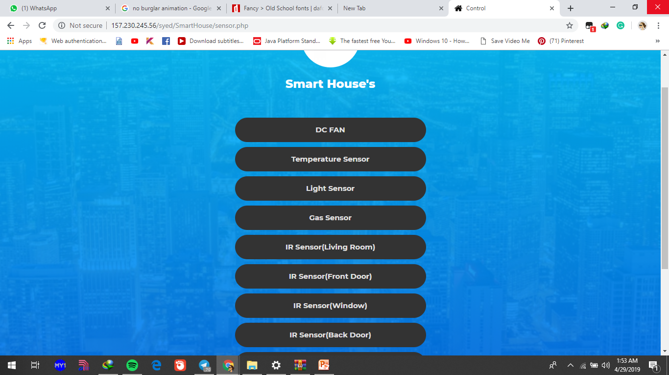
Control the light and fan using the website
Manage and monitor the sensor using the website

Slide 15



Software
Brackets
Arduino.ide
phpMyAdmin

Slide 16
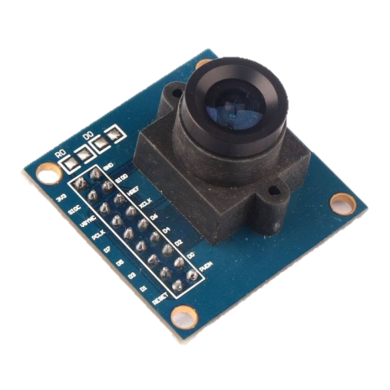
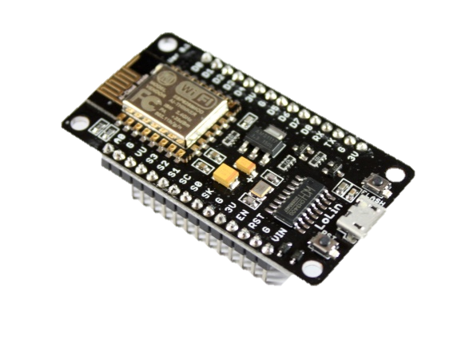
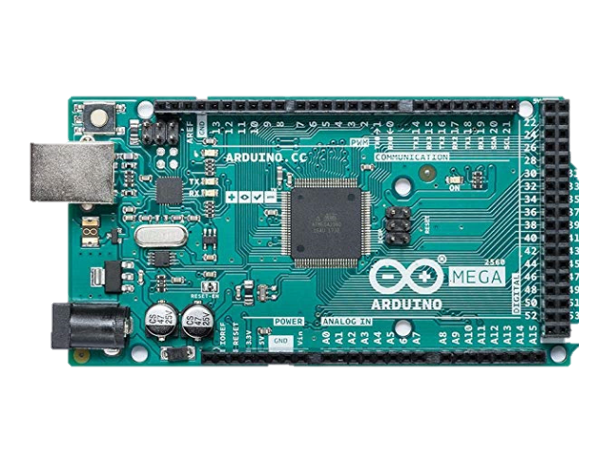
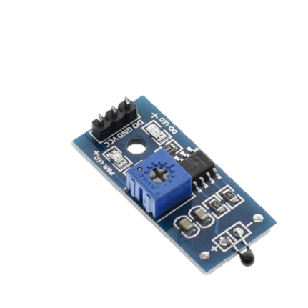
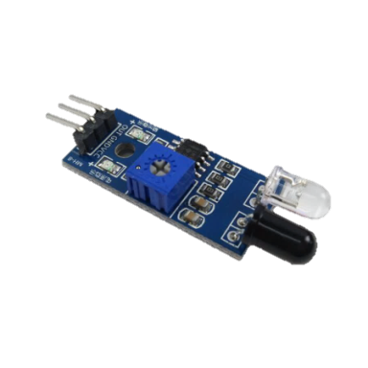
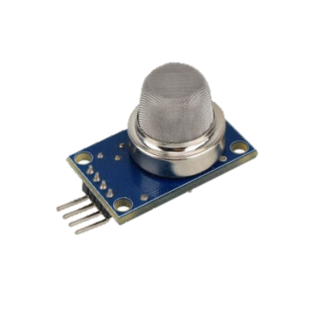
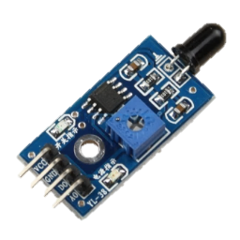
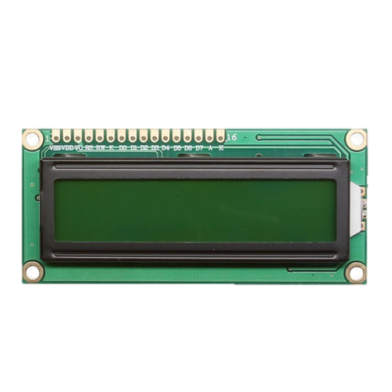
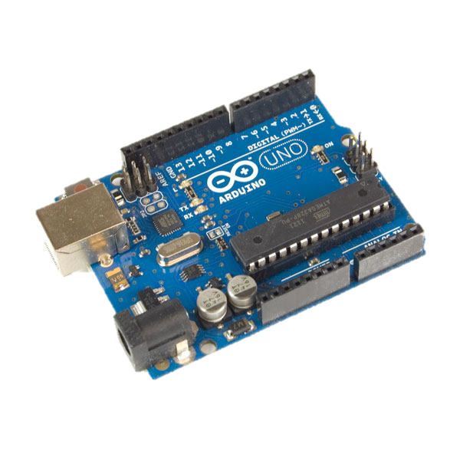
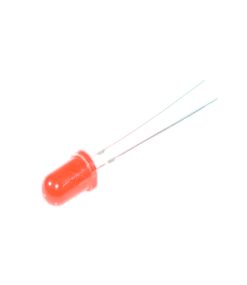
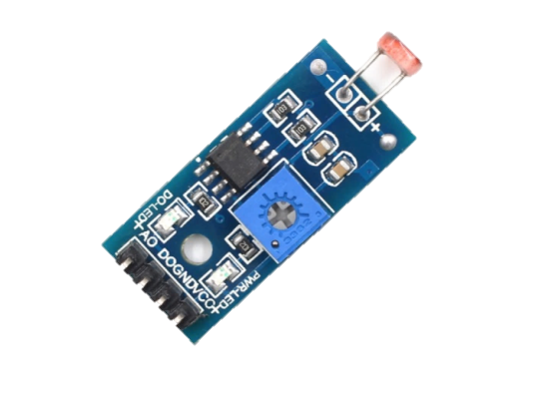
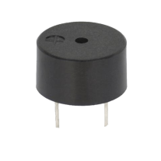
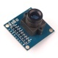
Hardware
NodeMCU wemos
Camera OV7670
Gas sensor
Infared sensor module
Flame sensor
Temperature sensor
Arduino MEGA
LED
Buzzer
Light sensor
LCD module
16x2
Arduino UNO

Slide 17
Project design & consideration

Slide 18
HEALTH AND SAFETY
Involve non-biochemical instrumentation such as fuel or gas as the equipment.
Does not produce air pollution.
Movement of the intruders will be detected using PIR sensor and the camera.
Alarm will turn on if the user not inside of the house and movement detected using the IR sensor.
Alarm also will turn on if it detect gas leak or flame.

Slide 19
ENVIRONMENTAL CONSIDERATION
Home owners can have more precise control over the heating and cooling of their home with mobile applications that learns their temperature preferences.
Save energy by remotely turn on and off all electrical appliance by using the website.
Fan will turn off if the temperature sensor detect a low value .

Slide 20
CULTURAL AND BENEFIT TO SOCIETY
Will reduce the probability that your house will be safe from any accidents such as the gas leak or burned house.
Will reduce the usage of electrical if the owner forget to turn off the electrical appliance remotely using the website.
Make the house safe from the intruders.

Slide 21
COSTING

Slide 22
Conclusion
System that support a lot of home automation systems. A smart home contains a connection between wireless communication, sensors, monitoring and tracking. provide security and control of the home easily.
These experiments show how to detect the fire, to detect smoke or gas leak.
Detect any intruder to the home.
This project showed the idea of measuring the temperature in all rooms and detect any fire happens and to detect any motion in the home by using ultrasonic sensors.
Central control for the entire home has been designed using Arduino MEGA system designs.

